Slide 1

Customer Relationship management analytics
Project Members
Aditya Thakare
Nikita Parate
Yugandhar Bhokare
Tejaswini
Prafulla Wankhede
Manish Dhawan
Mentors
Mahendra Singh
Dipti Sinha

Slide 2
Objective : To analyze the Salesforce customer relationship management data to improve the business relationships and simplify the marketing and sales process.
Tool : Tableau.
Dashboards :
Lead
Opportunity

Slide 3
KPI
Lead :
Lead by Sources
Lead By Industry
Opportunity :
Running Total Expected Vs Commit Forecast Amount over Time
Running Total Active Vs Total Opportunity over Time
Closed won Vs Total Opportunity over Time
Closed won Vs Total Closed over Time
Expected Amount by Opportunity Type
Opportunity By Industry

Slide 4
Lead A lead is an unqualified sales opportunity. A lead can be a company or an individual who is interest in our product or service.
KPI :
Lead By Source
Lead By Industry

Slide 5
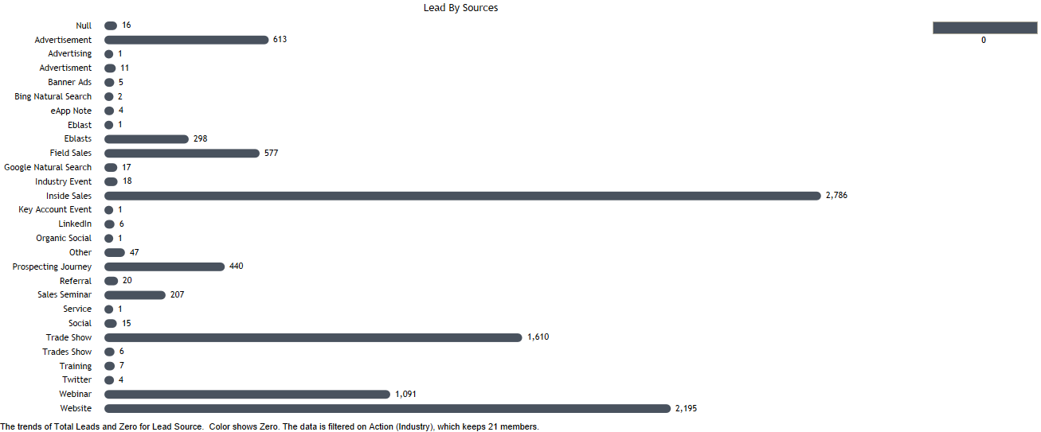
Lead by source This kpi shows the primary source by which lead found our business. The table shows total leads we get from various sources the bar graph shows that the Inside sales has the highest number of leads.
Source | Leads
Advertisement | 613
Advertising | 1
Advertisment | 11
Banner Ads | 5
Bing Natural Search | 2
eApp Note | 4
Eblast | 1
Eblasts | 298
Field Sales | 577
Google Natural Search | 17
Industry Event | 18
Inside Sales | 2786
Key Account Event | 1
LinkedIn | 6
Organic Social | 1
Other | 47
Prospecting Journey | 440
Referral | 20
Sales Seminar | 207
Service | 1
Social | 15
Trade Show | 1610
Trades Show | 6
Training | 7
Twitter | 4
Webinar | 1091
Website | 2195
Null | 16
Grand Total | 10000

Slide 6
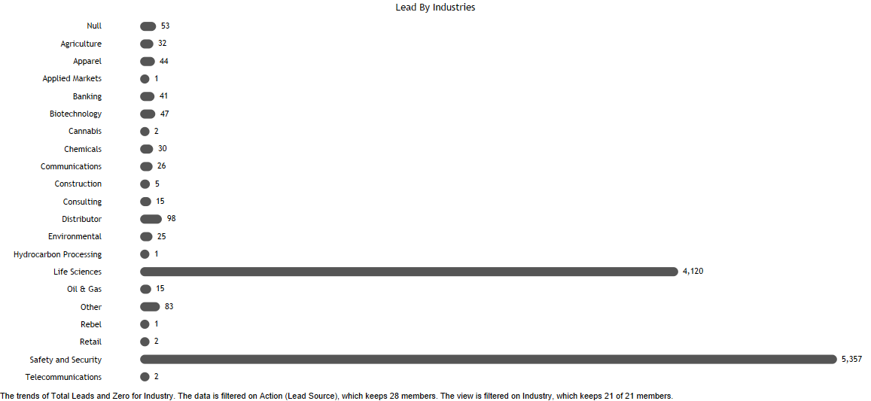
Lead by industry this kpi shows the industry-wise leads we have. The table shows all the industries and leads generated by them. The bar graph shows that the safety and security related industries has generated the highest leads that is 5357 leads.
Industry | Leads
Agriculture | 32
Apparel | 44
Applied Markets | 1
Banking | 41
Biotechnology | 47
Cannabis | 2
Chemicals | 30
Communications | 26
Construction | 5
Consulting | 15
Distributor | 98
Environmental | 25
Hydrocarbon Processing | 1
Life Sciences | 4120
Oil & Gas | 15
Other | 83
Rebel | 1
Retail | 2
Safety and Security | 5357
Telecommunications | 2
Null | 53
Grand Total | 10000

Slide 7
Lead Dashboard

Slide 8
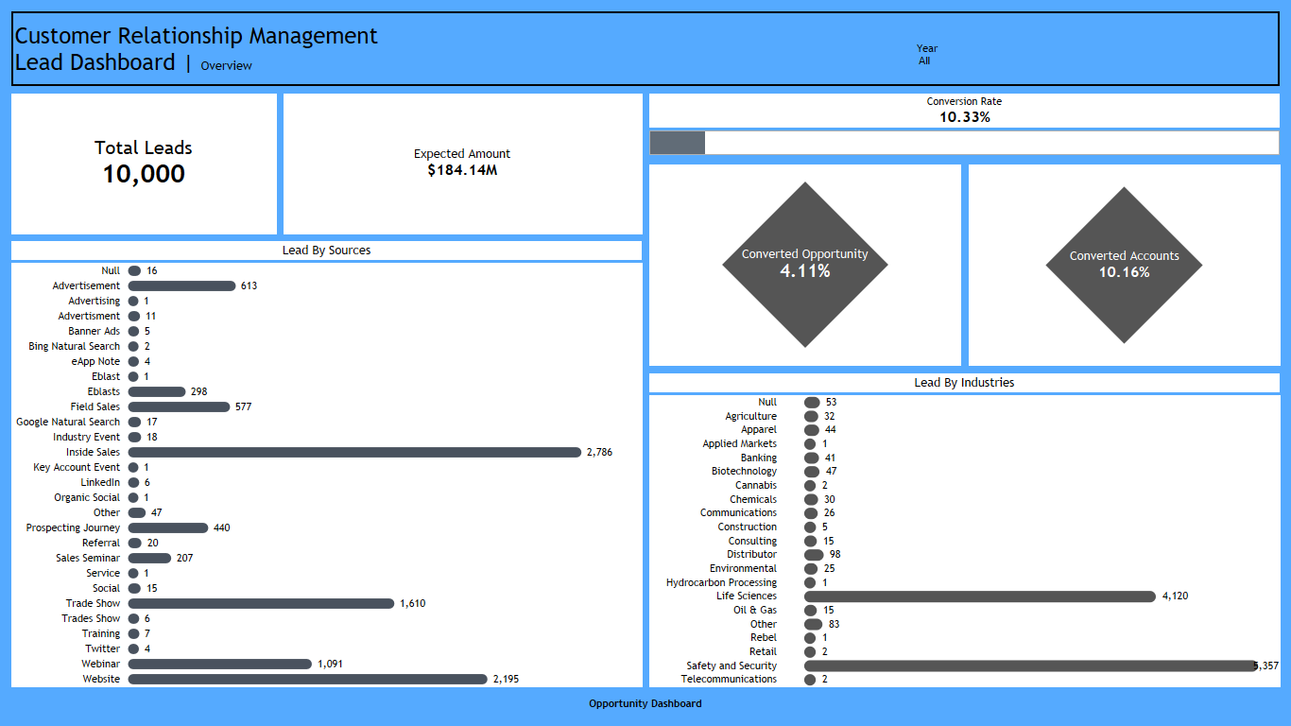

Slide 9
Opportunity Opportunities are deals in progress. Opportunity records track details about deals, including which accounts they're for, who the players are, and the amount of potential sales.
KPI :
Running Total Expected Vs Commit Forecast Amount over Time
Running Total Active Vs Total Opportunity over Time
Closed won Vs Total Opportunity over Time
Closed won Vs Total Closed over Time
Expected Amount by Opportunity Type
Opportunity By Industry

Slide 10
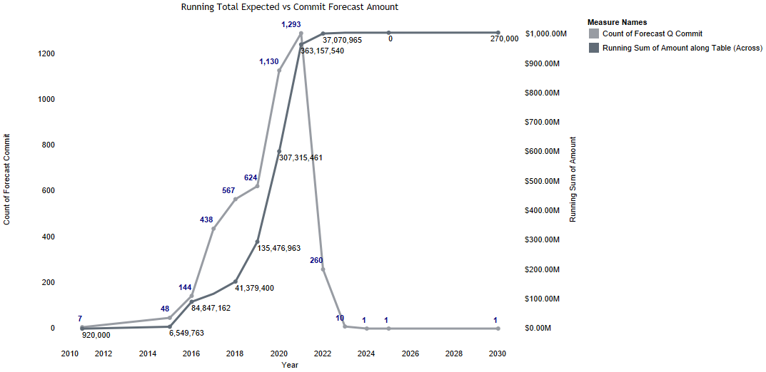
Running total expected Vs commit forecast amount A running total is the sum of a sequence of expected amount which is updated each time a new amount is added to the data, by adding the new amount to the previous running total. The Commit forecast amounts are the amounts that a user is confident about closing. This also includes closed/won opportunity amounts. This KPI show the trend of expected running total amount against the commit forecast amount.

Slide 11
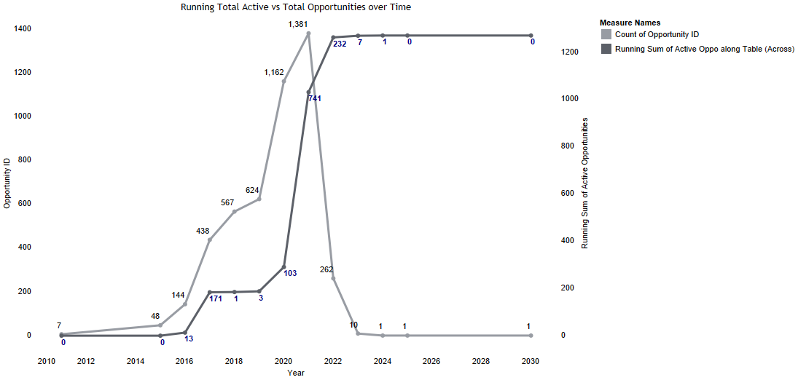
Running total active Vs total opportunities over time the running total active shows the running sum of active opportunities along the table. The Total opportunities shows the total count of opportunities we get each year. This kpi shows the yearly trend of running sum of active opportunities against the total number of opportunities .

Slide 12
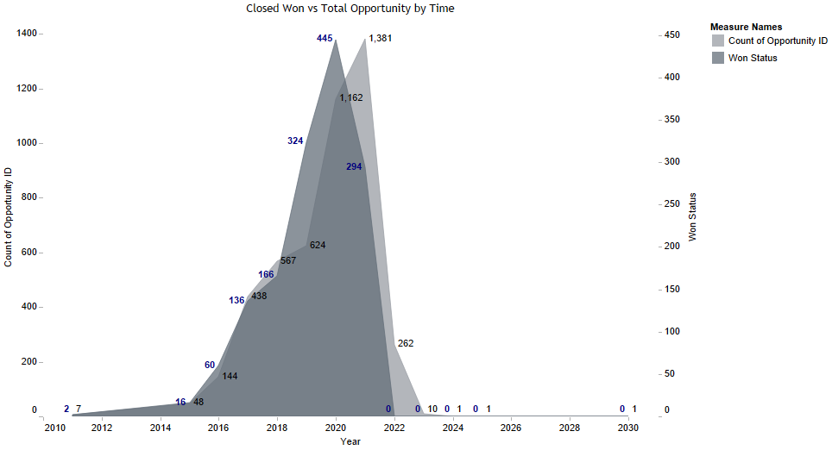
Closed won vs total opportunity over time the closed won shows the count of opportunities we won. The total opportunity show the total number of opportunities we have. The kpi shows the trend of total won opportunities against the total number of opportunities every year.

Slide 13
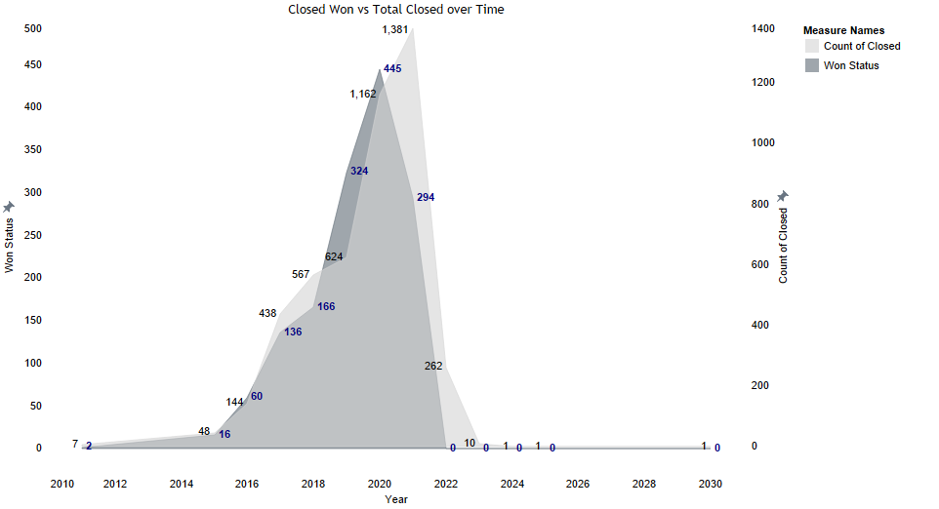
Closed won vs Total Closed over time the closed won shows the opportunities which we won. The total closed shows the total opportunities we closed. The kpi shows the trend of total opportunities we won against the total number of opportunities we closed over the years.

Slide 14
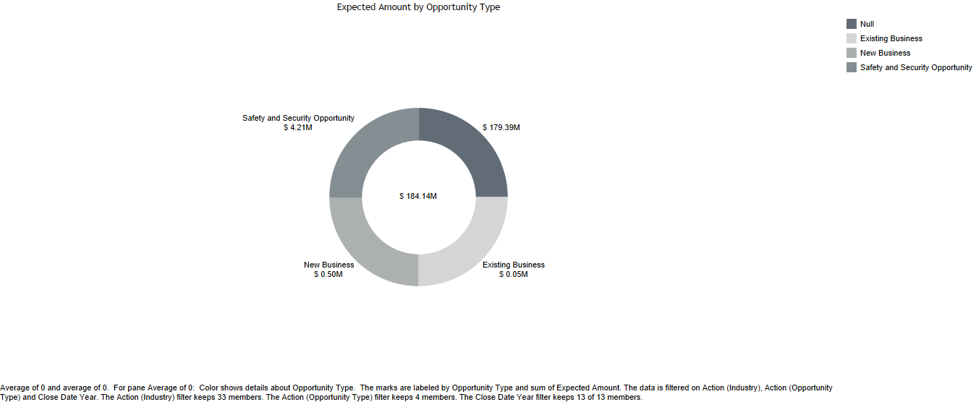
Expected Amount by opportunity type this kpi shows the amount we are expecting from each of the opportunity by their types. the table shows the type of opportunity and the expected amount. The pie diagram represents the type of opportunity and amount we are expecting from it.
Opportunity Type | Expected Amount
Existing Business | 50,000
New Business | 5,00,000
Safety and Security Opportunity | 42,05,450
Null | 17,93,88,519
Grand Total | 18,41,43,969

Slide 15
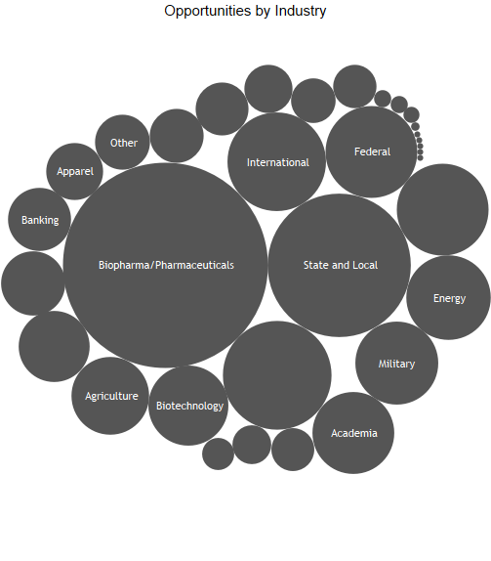
Opportunity by Industry this kpi shows the industry-wise count of opportunities we got. The table shows the total count of opportunities and industries. the Bubble chart display data as a cluster of circles. Each of the values in the Industry represents a circle whereas the count of opportunities represent the size of those circles.
Industry | Opportunities
Academia | 182
Agriculture | 164
Apparel | 88
Banking | 108
Biopharma/Biopharmaceuticals | 2
Biopharma/Pharmaceuticals | 1143
Biotechnology | 174
CDMOs | 1
Chemicals | 51
Commercial | 8
Communications | 229
Construction | 112
Consulting | 50
CRO / CDMO | 8
Distributor | 41
Education | 63
Electronics | 54
Energy | 194
Federal | 231
Government | 28
Hospitality | 79
International | 264
Law Enforcement | 1
Life Science Research | 7
Military | 187
Municipal | 1
Other | 82
State | 1
State & Local | 1
State and Local | 558
Telecommunications | 137
Transportation | 76
Null | 321
Grand Total | 4646

Slide 16
Opportunity Dashboard

Slide 17
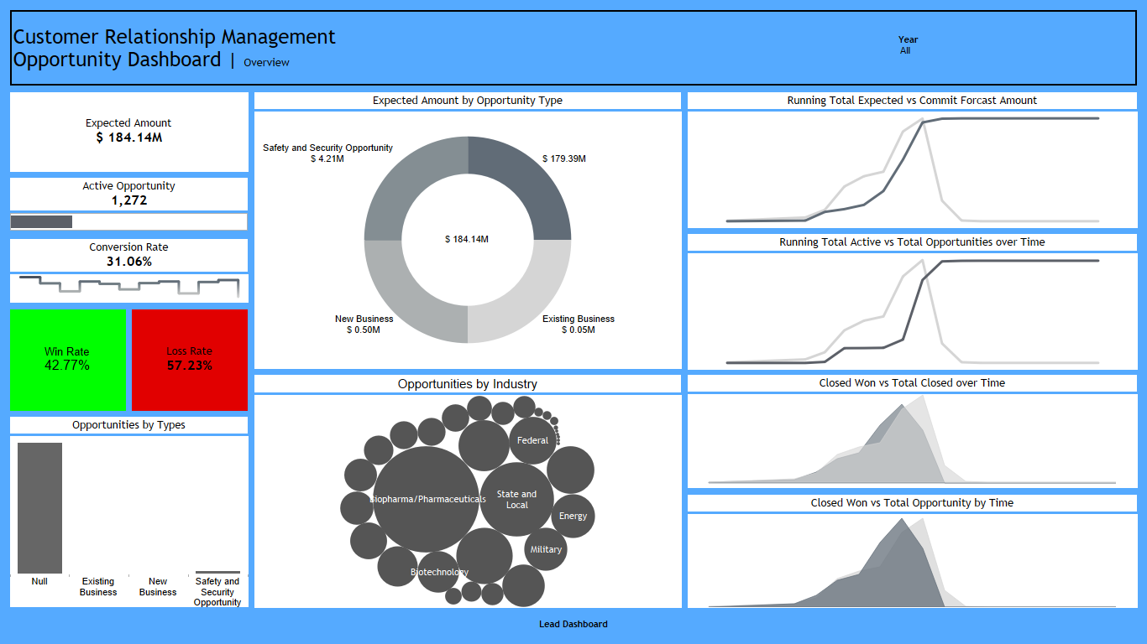

Slide 18
Thank You.

